Slide 1
Time-Series Anomaly Detection Service at Microsoft
Microsoft 2019

Slide 2
Anomaly Detection
Objective.
Discover unexpected events
Discover rare items in data
For,
Avoid loss in revenue
Maintain the reputation and branding

Slide 3
Anomaly Detection Service
As a result, when anomalies are detected, alerts will be sent to the operators to make timely decision related to incidents.

Slide 4



Anomaly Detection Service
Microsoft build an anomaly detection service to monitor millions of metrics coming from Bing, Office, and Azure.

Slide 5
Problem
Lack of labels
Generalization
Efficiency

Slide 6
Problem : Lack of labels
There is no easy way for users
to label each time-series manually.

Slide 7
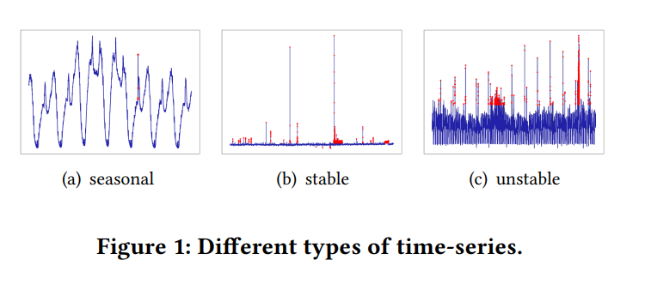
Problem : Generalization
Data distribution of time-series is constantly changing
Existing approaches are not generalized enough for different patterns.

Slide 8
Problem : Efficiency
In business applications, a monitoring system must process millions, even billions of time-series in near real time
Even though, the models with large time complexity are good at accuracy, they are often of little use

Slide 9
Related work
Traditional statistical models has low accuracy
Supervised models are superior in accuracy, but insufficient -> lack of labeled data
Unsupervised approaches such as Luminol and DONUT are parameter-sensitive and time-consuming

Slide 10
Method
Develop unsupervised manner
Focus on accuracy, efficiency and generality

Slide 11
Method
Spectral residual model
CNN

Slide 12
Method
CNN
Output of spectral residual model

Slide 13
Method : Spectral residual model
- Visual saliency domain
Basically, digital image have similar frequency information, but there are slight differences
“saliency” : 사진이나 장면에서 눈에 띄는 것. Time-series curve에서 anomalies가 해당 지점에서 관찰된다.

Slide 14
Method : Spectral residual model
How to get “saliency”
Image information in the spatial domain is transformed into the frequency domain using 2D Fourier transform. [log spectrum]
Predictable frequency information is subtracted from the frequency domain. [spectral residual]
Transform back to the spatial domain using inverse Fourier transform. [saliency map]

Slide 15
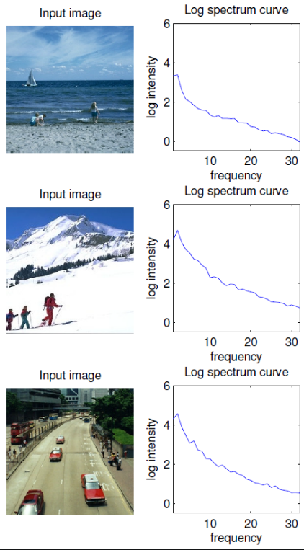
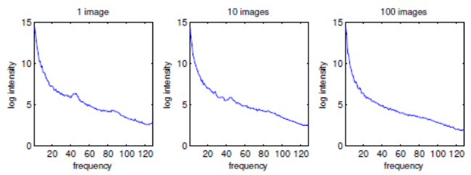
Method : Spectral residual model
[log spectrum]
Predictable frequency information
=
[spectral residual]

Slide 16
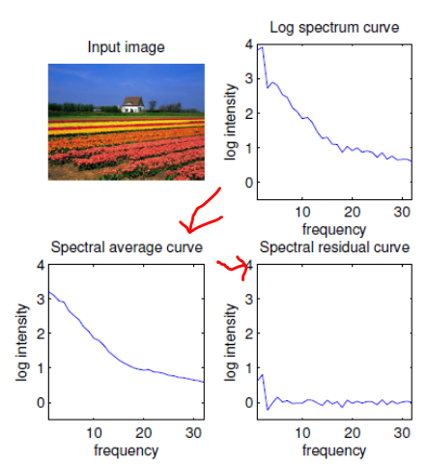
Method : Spectral residual model
[saliency map]
using inverse Fourier transform

Slide 17
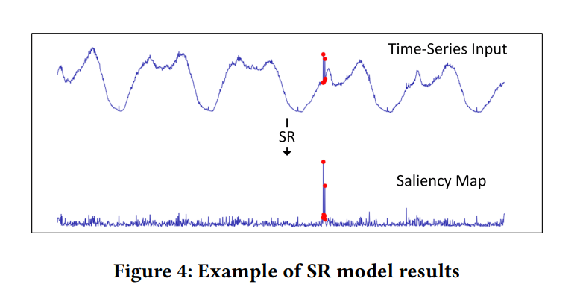
Method : Spectral residual model

Slide 18
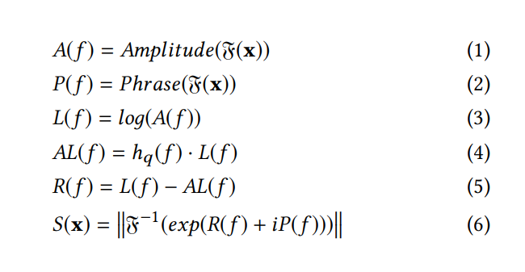
The result sequence S(x) is called the saliency map.
Method : Spectral residual model
The result sequence S(x) is called the saliency map.

Slide 19
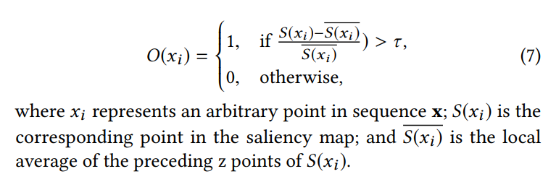
.
Method : Annotate anomaly point
Using sliding window
S(x) : saliency map

Slide 20
.
Method : Estimated point
Using sliding window
Add estimated points

Slide 21
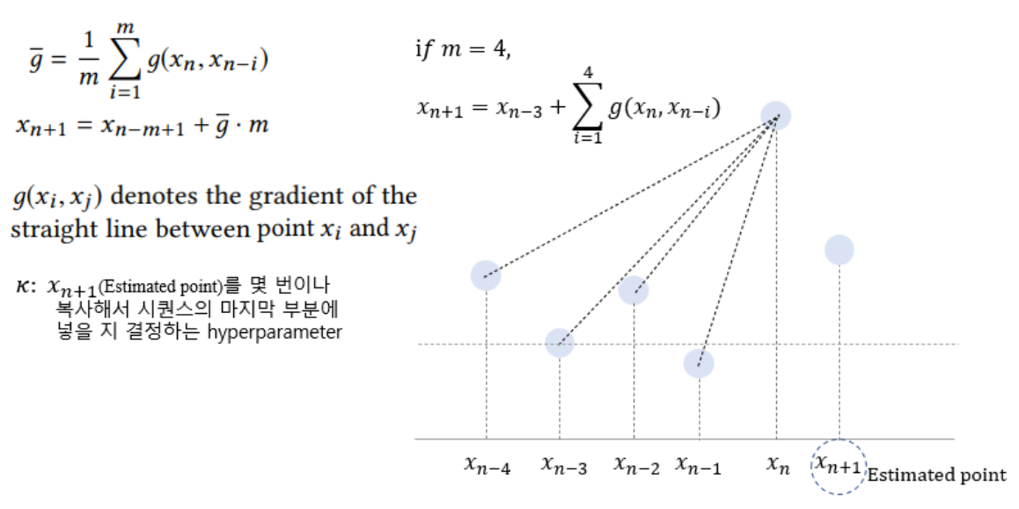
.
Method : Estimated point
m = 5

Slide 22
.
Method : Hyperparameter
Sliding window size
Estimated points number
Anomaly detection threshold

Slide 23
.
Method : CNN
Only using SR method with single threshold is so naive
SO, train CNN with well-designed synthetic data
The synthetic data can be generated using Saliency map

Slide 24
.
Method : CNN
Inject anomaly points in saliency map
How.
Randomly select several points in the time-series
Calculate the injection value to replace original point
Injection points are labeled as anomalies

Slide 25
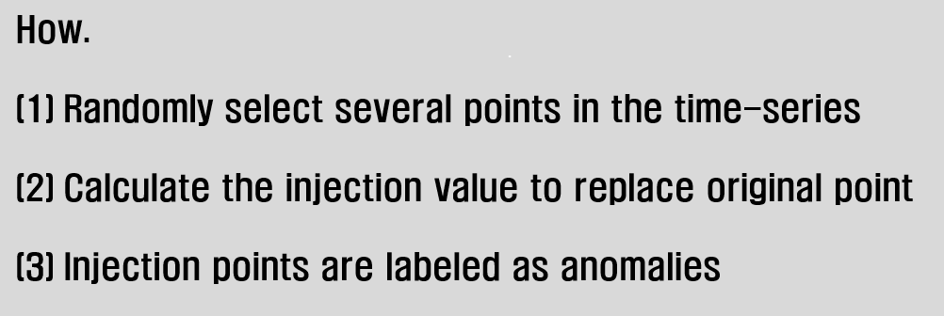

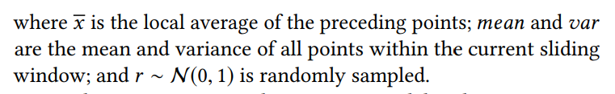
.
Method : CNN
Cross entropy, SGD

Slide 26
.
Method
Solve lack of labeled data & can easily create anomaly annotation

Slide 27
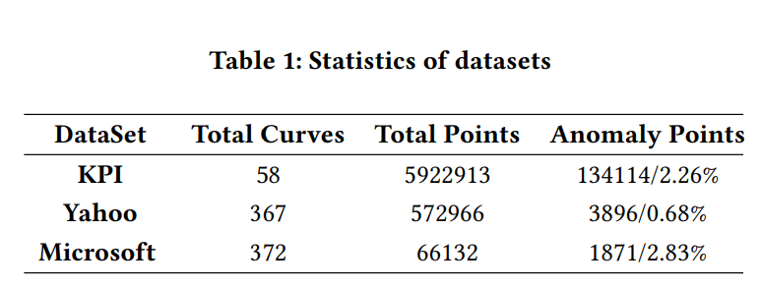
Experiment
Dataset.
KPI, Yahoo, Microsoft dataset
Evaluation.
Accuracy : precision, recall, F1-score
Efficiency : execution time
Generality : F1-score for each class

Slide 28
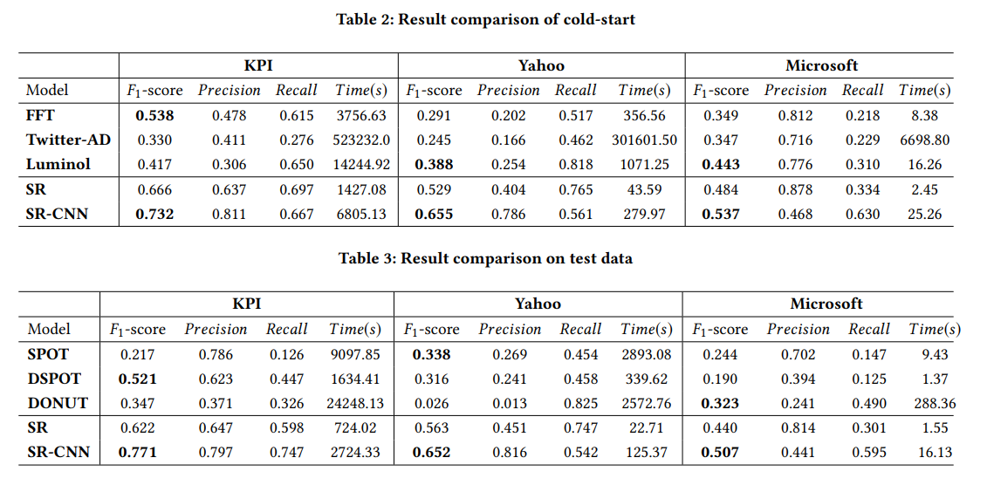
Experiment

Slide 29
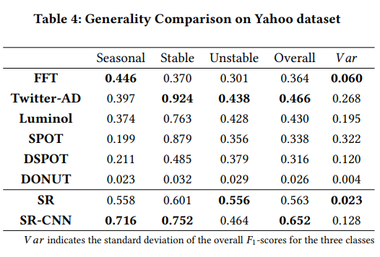
Experiment
Convincing result

